Slide 1
Water resources, water quality research methodology
Assoc. Prof. Tamriko Supatashvili
11 July
2022

Slide 2
How do you define water resources?
water resource, any of the entire range of natural waters that occur on the Earth, regardless of their state (i.e., vapour, liquid, or solid) and that are of potential use to humans.

Slide 3
Water resources are considered renewable natural resources, however For this, in today's ecological situation, two things need to be fulfilled Condition:
a) The part of the surface and underground water supply should not be used up, which is usually called century-old stock (glaciers, lakes, etc.).other).
b) the scale of Pollution of natural water as a result of human economic activity will not lead to irreversible processes in the hydrosphere.

Slide 4
Types of water resources:
Natural
Artificial
Well
Dam
Surface water
Ground water
Rain water
Reservoirs
River
Lake
Sea
Ocean

Slide 5
Water resources in Georgia:
Georgia is rich with water resources:
860 lakes;
more than 26,000 rivers;
43 artificial reservoirs;
More than 730 mineral water.

Slide 6
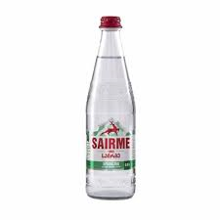
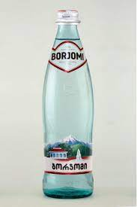
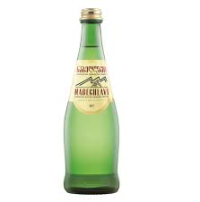
Mineral Wates in Georgia
There are more than 730 types of mineral water in Georgia, which are used for balneological purposes and industrial casting.
Among them the most famous are:
Borjomi;
Sairme;
Likani;
Nabeghlavi;
Mitarbi;
Zvare;
Lugela.

Slide 7
what is the difference between mineral water and regular water?

Slide 8
what is the difference between mineral water and regular water?
Mineral water comes from underground reservoirs. Unlike regular drinking water;
As the name suggests, mineral water contains high quantities of minerals, especially magnesium, calcium, and sodium.
The mineral components in mineral water varies and may include zinc, iron, calcium, magnesium.

Slide 9
what is the difference between mineral water and regular water?
Total mineralization (dry balance) g/l
Drinking water – no more than 1,5 ;
Mineral water – from 1.5 to 15.

Slide 10
Characteristics of mineral waters
Name of mineral water | Name of group | Mineralization g/l | Main ions mg*eq/l | Specific component | Use of water
Borjomi | Hydro carbonate-sodium | 5.6-7.2 | HCO3 Na | CO2 | Inner Outer
Nabeghlavi | Hydro carbonate-sodium | 6.2 | HCO3 Na | CO2 | Inner Outer
Sairme | Hydro carbonate-sodium | 7.2 | HCO3 Na | H₃BO₃ Fe, CO₂ | Inner
Mitarbi | Hydro carbonate-sodium-calcium | 2.4 | HCO3 Na Ca | CO2 | Inner
Lugela | Chloride-calcium-bromine | 42.1 | Cl Ca | Br | Inner

Slide 11
Water Quality
Water quality describes the condition of the water, including chemical, physical, and biological characteristics, usually with respect to its suitability for a particular purpose such as drinking or swimming.

Slide 12
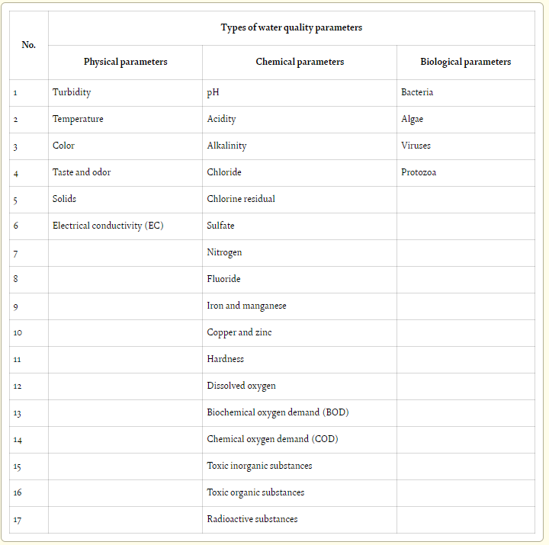
MAIN Controlling parameters in water
Three Main Types of Water Quality Parameters
Physical Parameters of Water Quality;
Chemical Parameters of Water Quality;
Biological Parameters of Water Quality.

Slide 13
Physical Parameters of Water Quality
Turbidity;
Temperature;
Color;
Taste and Odor;
Solids;
Electrical Conductivity.

Slide 14
Chemical Parameters of Water Quality
PH;
Acidity;
Alkalinity;
Hardness;
Dissolved Oxygen;
Biological Oxygen Demand.

Slide 15
Chemical composition of natural water:
1. Main ions;(The main anions are Cl⁻ , SO₄ ²⁻, HCO₃ ⁻ , and CO₃ ²⁻ and the main cations are Ca²⁺, Na⁺ , Mg²⁺ and K⁺ ).
2. Dissolved gases;
3. Biogeneous substances (SILICA; NITROGEN; PHOSPHORUS);
4. Organic substances;
5. Microelements (Mn, Mo, Co, As, Se, I, Br, F)
6. Pollutants (bacteria, viruses, parasites, fertilisers, pesticides, pharmaceutical products, nitrates, phosphates, plastics, faucal waste and even radioactive substances).

Slide 16
Biological Parameters of Water Quality
Bacteria;
Algae;
Viruses.

Slide 17
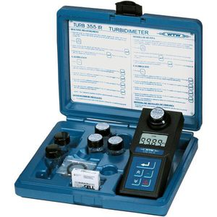
Physical Parameters of Water Quality
Turbidity
Turbidity is the cloudiness of water. It is a measure of the ability of light to pass through water. It is caused by suspended material such as clay, silt, organic material, plankton, and other particulate materials in water.
Turbidity is measured by an instrument called nephelometric turbidimeter, which expresses turbidity in terms of NTU or TU. A TU is equivalent to 1 mg/L of silica in suspension.
Turbidity more than 5 NTU can be visible to the average person while turbidity in muddy water, it exceeds 100 NTU . Groundwater normally has very low turbidity because of the natural filtration that occurs as the water penetrates through the soil.

Slide 18
Physical Parameters of Water Quality
Temperature
Palatability, viscosity, solubility, odors, and chemical reactions are influenced by temperature. Thereby, the sedimentation and chlorination processes and biological oxygen demand (BOD) are temperature dependent . It also affects the biosorption process of the dissolved heavy metals in water . Most people find water at temperatures of 10–15°C most palatable.
Color
Materials decayed from organic matter, namely, vegetation and inorganic matter such as soil, stones, and rocks impart color to water, which is objectionable for esthetic reasons, not for health reasons.
Color is measured by comparing the water sample with standard color solutions or colored glass disks. One color unit is equivalent to the color produced by a 1 mg/L solution of platinum (potassium chloroplatinate (K₂PtCl₆).
True color is measured after filtering the water sample to remove all suspended material.
Color is graded on scale of 0 (clear) to 70 color units. Pure water is colorless, which is equivalent to 0 color units.

Slide 19
Physical Parameters of Water Quality
Taste and odor
Taste and odor in water can be caused by foreign matter such as organic materials, inorganic compounds, or dissolved gasses. These materials may come from natural, domestic, or agricultural sources.
The numerical value of odor or taste is determined quantitatively by measuring a volume of sample A and diluting it with a volume of sample B of an odor-free distilled water so that the odor of the resulting mixture is just detectable at a total mixture volume of 200 ml.

Slide 20
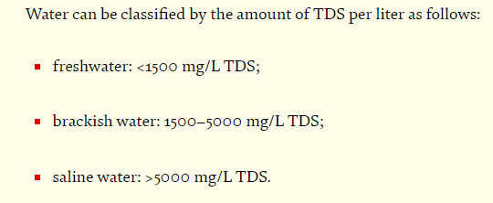
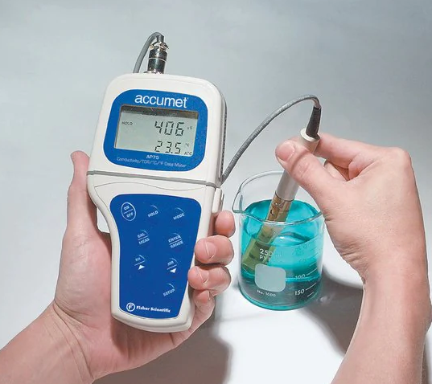
Physical Parameters of Water Quality
Solids
Solids occur in water either in solution or in suspension. These two types of solids can be identified by using a glass fiber filter that the water sample passes through. By definition, the suspended solids are retained on the top of the filter and the dissolved solids pass through the filter with the water .
If the filtered portion of the water sample is placed in a small dish and then evaporated, the solids as a residue. This material is usually called total dissolved solids or TDS.

Slide 21
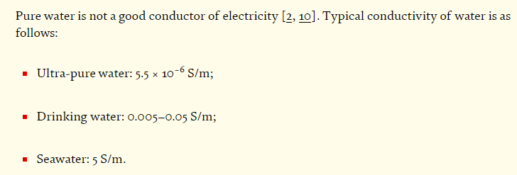
Physical Parameters of Water Quality
Electrical conductivity (EC)
The electrical conductivity (EC) of water is a measure of the ability of a solution to carry or conduct an electrical current. Since the electrical current is carried by ions in solution, the conductivity increases as the concentration of ions increases. Therefore, it is one of the main parameters used to determine the suitability of water for irrigation and firefighting.

Slide 22
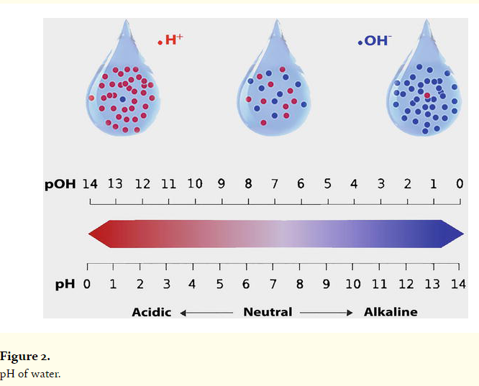
Chemical Parameters of Water Quality
pH
pH is one of the most important parameters of water quality. It is defined as the negative logarithm of the hydrogen ion concentration.
Actually, pH of water is a measure of how acidic/basic water is. Acidic water contains extra hydrogen ions (H⁺) and basic water contains extra hydroxyl (OH⁻) ions.
Pure water is neutral, with a pH close to 7.0 at 25°C.
Normal rainfall has a pH of approximately 5.6 (slightly acidic) owing to atmospheric carbon dioxide gas. Safe ranges of pH for drinking water are from 6.5 to 8.5.
The effects of pH on other chemicals in water can be summarized as follows:
Heavy metals such as cadmium, lead, and chromium dissolve more easily in highly acidic water (lower pH). This is important because many heavy metals become much more toxic when dissolved in water.
A change in the pH can change the forms of some chemicals in the water. Therefore, it may affect aquatic plants and animals.

Slide 23
Chemical Parameters of Water Quality
Acidity
Acidity is the measure of acids in a solution. The acidity of water is its quantitative capacity to neutralize a strong base to a selected pH level.
Acidity in water is usually due to carbon dioxide, mineral acids, and hydrolyzed salts such as ferric and aluminum sulfates. Acids can influence many processes such as corrosion, chemical reactions and biological activities.
Carbon dioxide from the atmosphere or from the respiration of aquatic organisms causes acidity when dissolved in water by forming carbonic acid (H₂CO₃).
The level of acidity is determined by titration with standard sodium hydroxide (0.02 N) using phenolphthalein as an indicator.

Slide 24
Chemical Parameters of Water Quality
alkalinity
The alkalinity of water is its acid-neutralizing capacity comprised of the total of all titratable bases. The measurement of alkalinity of water is necessary to determine the amount of lime and soda needed for water softening (e.g., for corrosion control in conditioning the boiler feed water).
Alkalinity of water is mainly caused by the presence of hydroxide ions (OH⁻), bicarbonate ions (HCO³⁻), and carbonate ions (CO₃²⁻), or a mixture of two of these ions in water.
Alkalinity is determined by titration with a standard acid solution (H₂SO₄ of 0.02 N) using selective indicators (methyl orange or phenolphthalein).
The high levels of either acidity or alkalinity in water may be an indication of industrial or chemical pollution. Alkalinity or acidity can also occur from natural sources such as volcanoes. The acidity and alkalinity in natural waters provide a buffering action that protects fish and other aquatic organisms from sudden changes in pH.

Slide 25
Chemical Parameters of Water Quality
Hardness
Hardness is a term used to express the properties of highly mineralized waters. The dissolved minerals in water cause problems such as scale deposits in hot water pipes and difficulty in producing lather with soap.
Calcium (Ca2+) and magnesium (Mg2+) ions cause the greatest portion of hardness in naturally occurring waters. They enter water mainly from contact with soil and rock, particularly limestone deposits.
These ions are present as bicarbonates, sulfates, and sometimes as chlorides and nitrates. Generally, groundwater is harder than surface water.
There are two types of hardness: • Temporary hardness which is due to carbonates and bicarbonates can be removed by boiling, and • Permanent hardness which is remaining after boiling is caused mainly by sulfates and chlorides.
Hardness is normally determined by titration with ethylene diamine tetra acidic acid or (EDTA) and Eriochrome Black and Blue indicators. It is usually expressed in terms of mg/L of CaCO3.

Slide 26
Water classification according to hardness

Slide 27
Chemical Parameters of Water Quality
Dissolved oxygen
Dissolved oxygen (DO) is considered to be one of the most important parameters of water quality in streams, rivers, and lakes. It is a key test of water pollution. The higher the concentration of dissolved oxygen, the better the water quality.
Oxygen is slightly soluble in water and very sensitive to temperature. For example, the saturation concentration at 20°C is about 9 mg/L and at 0°C is 14.6 mg/L.
There are three main methods used for measuring dissolved oxygen concentrations: the colorimetric method—quick and inexpensive, the Winkler titration method—traditional method, and the electrometric method.

Slide 28
Chemical Parameters of Water Quality
Biochemical oxygen demand (BOD)
Bacteria and other microorganisms use organic substances for food. As they metabolize organic material, they consume oxygen. The organics are broken down into simpler compounds, such as CO2 and H2O, and the microbes use the energy released for growth and reproduction. When this process occurs in water, the oxygen consumed is the DO in the water. If oxygen is not continuously replaced by natural or artificial means in the water, the DO concentration will reduce as the microbes decompose the organic materials. This need for oxygen is called the biochemical oxygen demand (BOD).
The quantity of oxygen used in a specified volume of water to fully decompose or stabilize all biodegradable organic substances is called the ultimate BOD or BODL. BOD is a function of time. At time = 0, no oxygen will have been consumed and the BOD = 0. As each day goes by, oxygen is used by the microbes and the BOD increases. Ultimately, the BODL is reached and the organic materials are completely decomposed.

Slide 29
Chemical Parameters of Water Quality
Chemical oxygen demand (COD)
The chemical oxygen demand (COD) is a parameter that measures all organics: the biodegradable and the non-biodegradable substances. It is a chemical test using strong oxidizing chemicals (potassium dichromate), sulfuric acid, and heat, and the result can be available in just 2 h. COD values are always higher than BOD values for the same sample.

Slide 30
Chemical Parameters of Water Quality
Toxic inorganic substances A wide variety of inorganic toxic substances may be found in water in very small or trace amounts. Even in trace amounts, they can be a danger to public health.
Some toxic substances occur from natural sources but many others occur due to industrial activities and/or improper management of hazardous waste.
. They can be divided into two groups: • Metallic compounds: This group includes some heavy metals that are toxic, namely, cadmium (Cd), chromium (Cr), lead (Pb), mercury (Hg), silver (Ag), arsenic (As), barium (Ba), thallium (Tl), and selenium (Se) [22, 28]. They have a wide range of dangerous effects that differ from one metal to another. They may be acute fatal poisons such as (As) and (Cr6+) or may produce chronic diseases.
The heavy metals concentration can be determined by atomic absorption photometers, spectrophotometer, or inductively coupled plasma (ICP) for very low concentration. •
Nonmetallic compounds: This group includes nitrates (NO3 − ) and cyanides (CN− ) and etc.

Slide 31
Chemical Parameters of Water Quality
Toxic organic substances
There are more than 100 compounds in water that have been listed in the literature as toxic organic compounds. They will not be found naturally in water; they are usually man-made pollutants.
These compounds include insecticides, pesticides, solvents, detergents, and disinfectants. They are measured by highly sophisticated instrumental methods, namely, gas chromatographic (GC), highperformance liquid chromatographic (HPLC), and mass spectrophotometric.

Slide 32
Chemical Parameters of Water Quality
Radioactive substances
Potential sources of radioactive substances in water include wastes from nuclear power plants, industries, or medical research using radioactive chemicals and mining of uranium ores or other radioactive materials.
When radioactive substances decay, they release beta, alpha, and gamma radiation [34]. Exposure of humans and other living things to radiation can cause genetic and somatic damage to the living tissues [34, 35].
Radon gas is of a great health concern because it occurs naturally in groundwater and is a highly volatile gas, which can be inhaled during the showering process [35]. For drinking water, there are established standards commonly used for alpha particles, beta particles, photons emitters, radium-226 and -228, and uranium.
The unit of radioactivity used in water quality applications is the picocurie per liter (pCi/L); 1 pCi is equivalent to about two atoms disintegrating per minute. There are many sophisticated instrumental methods to measure it.

Slide 33
Main ions in water:
The main anions are Cl⁻ , SO₄ ²⁻, HCO₃⁻ .
Chloride (Cl⁻ ) determines by volumetric analysis, particularly- Morh method:

Slide 34
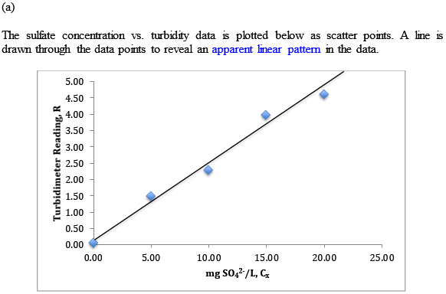
Main ions in water:
The main anions are Cl⁻ , SO₄ ²⁻, HCO₃⁻ .
Sulfate (SO₄ ²⁻ ) determines by colorimetric analysis, particularly- turbidymetric method:

Slide 35
Main ions in water:
The main anions are Cl⁻ , SO₄ ²⁻, HCO₃⁻ .
hydro carbonate (HCO₃⁻ ) determines by volumetric analysis, particularly- neutralization titration method:
Titration by 0.1 N HCl solution
Indicator methyl orange
Color change orange to pink.

Slide 36
Main ions in water:
the main cations are Ca²⁺; Mg²⁺ ; Na⁺ and K⁺ .
Calcium and magnesium (Ca²⁺; Mg²⁺ ) determine by volumetric analysis, particularly- complex formation titration.
Titrant is 0.1 N EDTA
Indicator is eriocrome black
Color change wine red to blue.

Slide 37
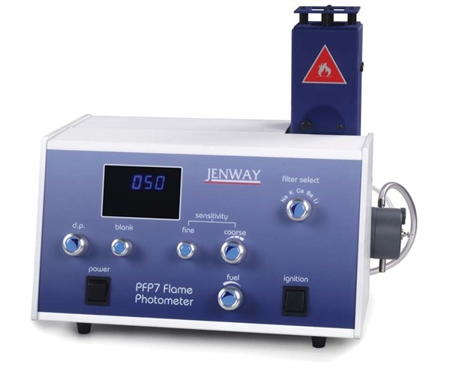
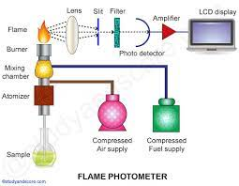
Main ions in water:
the main cations are Ca²⁺; Mg²⁺ ; Na⁺ and K⁺ .
Sodium and potassium (Na⁺ and K⁺ ) determine by flame photometer

Slide 38
Analytical methods in water quality control
Water analysis requires the use of various methods of analytical chemistry
volumetric titration
Atomic absorption spectrometry (AAS)
Colorimetric methods
flame atomic absorption spectrometry (FAAS)
Chromatography
inductively coupled plasma atomic emission spectrometry (ICPAES)

Slide 39
Analytical methods in water quality control
volumetric titration
Hardness;
Acidity;
Alkalinity;
Dissolved oxygen.

Slide 40
Analytical methods in water quality control
Colorimetric methods
Turbidity;
Color;
Nitrates;
Nitrites;
Amonium.

Slide 41
Analytical methods in water quality control
Atomic absorption spectrometry (AAS)
Heavy metals.

Slide 42
Analytical methods in water quality control
flame atomic absorption spectrometry (FAAS)
suitable for measurement of a limited range of elements present at concentrations greater than approximately 1 μg ml⁻¹

Slide 43
Analytical methods in water quality control
inductively coupled plasma atomic emission spectrometry (ICPAES)
favorable analytical results are obtained for approximately 70 elements, with detection limits usually reaching the ppb level;

Slide 44
Analytical methods in water quality control
Chromatography
Organic compounds.

Slide 45
Water quality requirements
Water quality requirements differ depending on the proposed used of water.
” Water quality requirements should be agreed with the water quality standards, which are put down by the governmental agency and represent the legislation requirements.
In general, there are three types of standards: in-stream, potable water, and wastewater effluent, each type has its own criteria by using the same methods of measurement.
The World Health Organization (WHO) has established minimum standards for drinking water that all countries are recommended to meet.

Slide 46
Causes of Water Pollution
Natural Causes
Human Causes
Plastic
Chemicals
Nutrients
Oil
Volcanoes
Floods
Radioactive Waste
Highway Runoff
Animal waste
Algae
Sewage

Slide 47
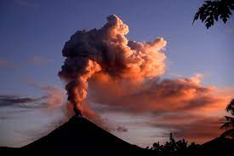
which contaminant comes from volcanoes in water resources?
When a volcano erupts, ash can travel great distances. In the short term, ash can contaminate vegetation, surface water, soils and groundwater with heavy metals like copper, cadmium and arsenic and non-metal contaminants like fluorine.

Slide 48
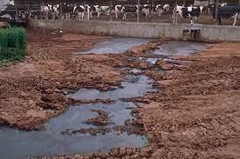
which contaminant comes from animal waste in water resources?
The primary pollutants associated with animal wastes are nutrients (particularly nitrogen and phosphorus), organic matter, solids, pathogens, and odorous/volatile compounds.

Slide 49
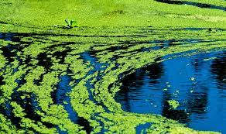
which contaminant comes from Algae in water resources?
Cyanotoxins are a group of chemical contaminants formed by blue-green algae. The most common type is microcystin, which is toxic to humans and animals.

Slide 50
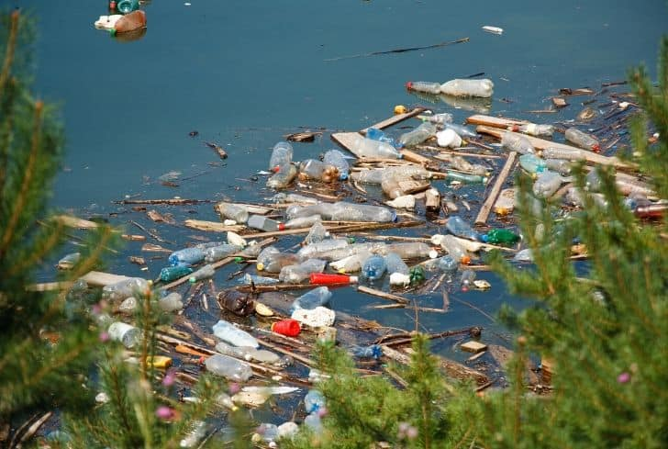
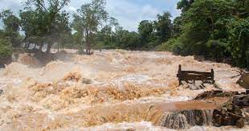
which contaminant comes from flood in water resources?
floods can carry with it harmful contaminants such as soil, animal waste, salt, pesticides, and oil which can potentially impact drinking water wells and water quality.

Slide 51
some interesting facts
Diseases from contaminated water have killed more people in history than any war. Today, nearly 5 million people worldwide die each year as a result of contaminated water.

Slide 52
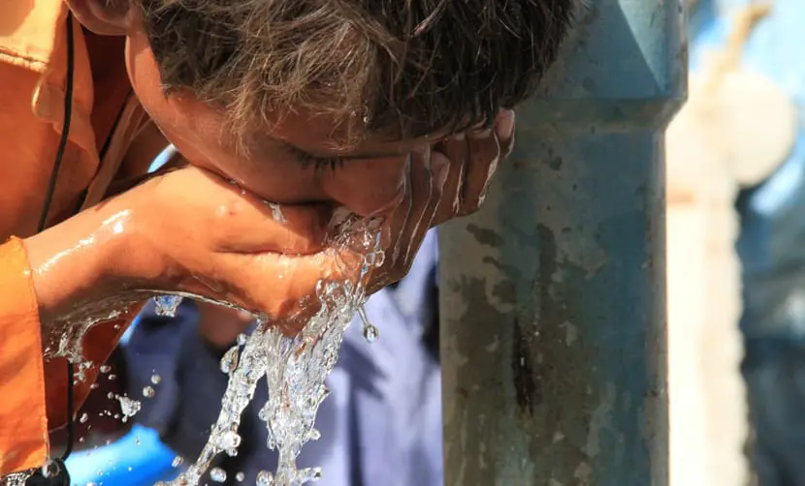
some interesting facts
The World Health Organization (WHO) confirms that 25% of global deaths are related to the lack of access to drinking water, air pollution and sanitation.

Slide 53
References:
Supatashvili guram., ,,Environmental chemistry’’. 2008;
Trapaidze vazha., ,water recources’’. 2012;
Nayla Hassan Omer., ,,Water Quality Parameters’’.2019. DOI:10.5772/intechopen.89657;
Supatashvili guram., ,, Quantitative analysis’’, Tbilisi state university. 2011
World Health Organization., ,,Guidelines for drinking-water quality’’ fourth edition incorporating the first and second addenda ISBN 978-92-4-004506-4 (electronic version). 2022.
https://www.vedantu.com/biology/causes-of-water-pollution

